Slide 1
Why don’t we just use Excel?

Slide 2
Consider a very small family business, an English as a Foreign Language school
Martina Jenkins, the owner
Simon Jenkins, her husband
Lorraine Jenkins, Simon’s sister
Lucy Young, a graduate they know

Slide 3
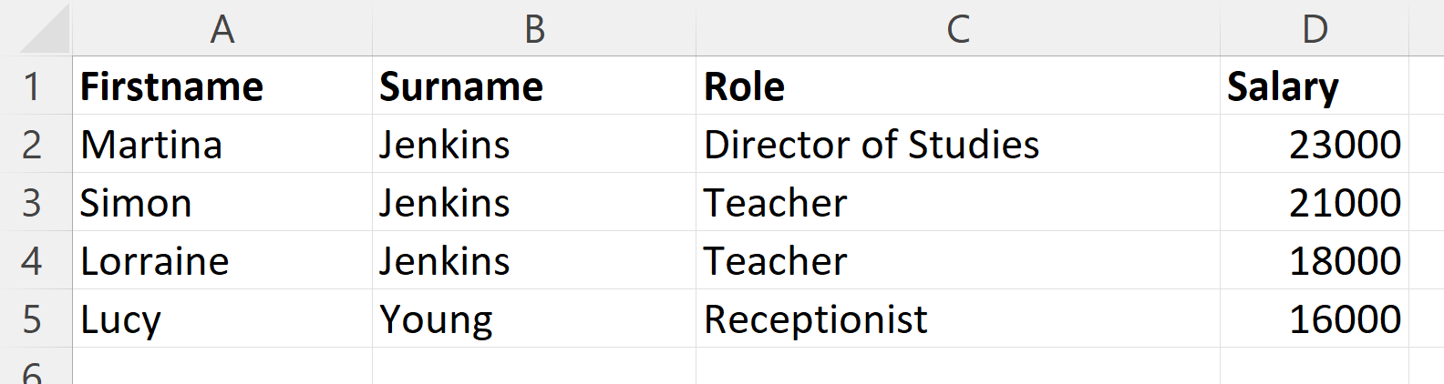
Notes:
That’s sufficient, surely?
But the business grows and more people join.
As a result the Excel spreadsheet has grown too, but it’s still manageable, right?

Slide 4
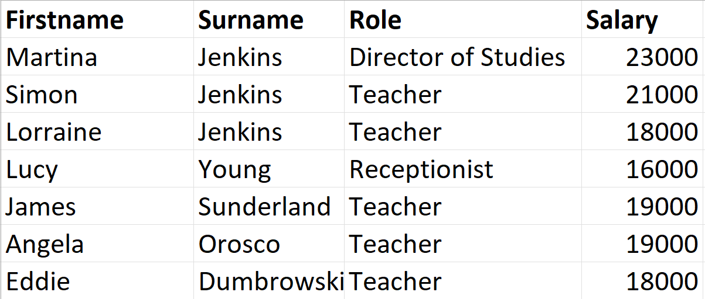
Notes:
The business proves successful.
So much so that they move to a new premises.
This one has a car park.
They employ Walter Sullivan as car park warden.

Slide 5
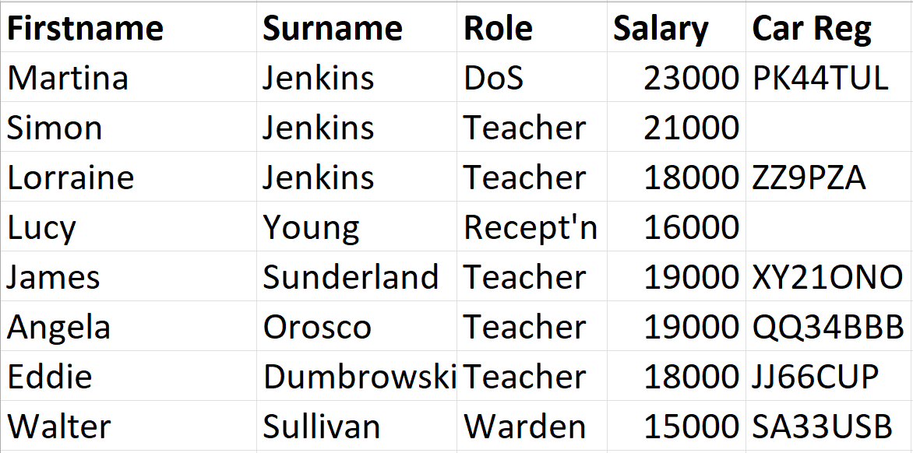
Notes:
TMI?
One morning, the owner of QQ34BBB leaves their car lights on.
Walter notices while doing his rounds.
He has access to the spreadsheet.
He checks it to see who owns QQ34BBB.

Slide 6
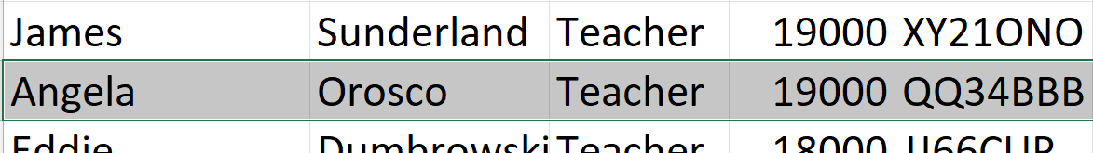
Notes:
He sees that it’s Angela’s car and phones reception.
Lucy on reception alerts Angela.
Walter also sees how much Angela earns. He doesn’t need to know that!

Slide 7
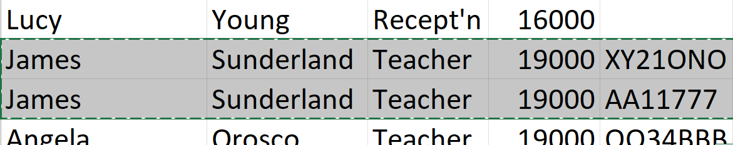
Notes:
James decides to buy a second car.
This is added to the Excel file.
But there is only one field for car registration.
So they duplicate his details.
Smart solution, right?

Slide 8
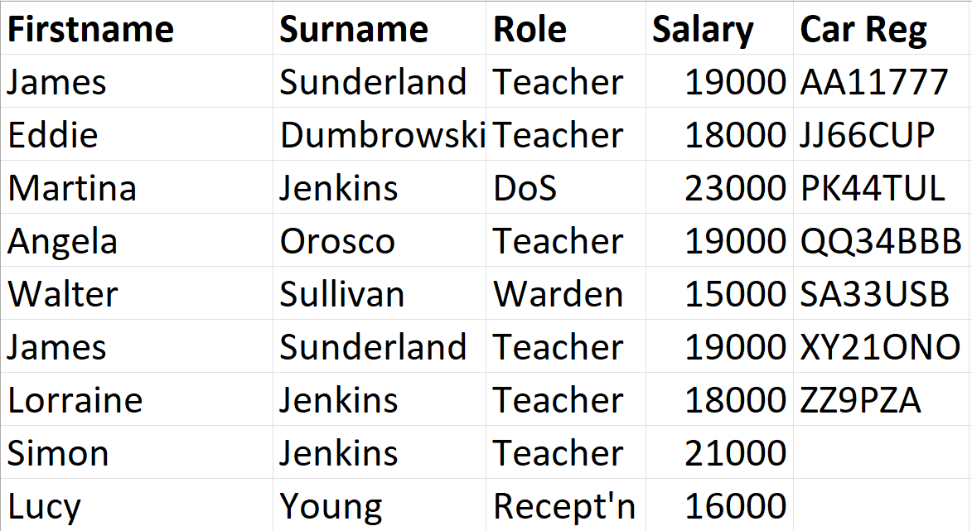
Notes:
One day, James gets a pay rise of £1000.
On the same day, somebody decided to sort the file by car registration number for some reason.

Slide 9
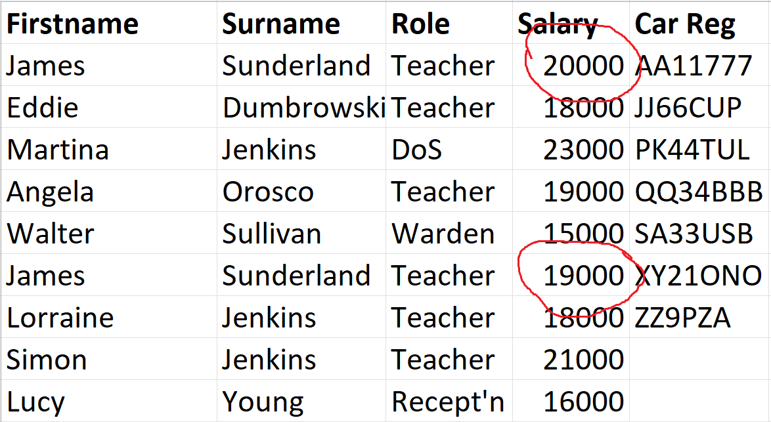
Notes:
James’ salary is adjusted to allow for his pay rise…
…but only in one place!
When they pay him, which one do they read?

Slide 10
Other possible problems
The spreadsheet might include phone number and address, all of which can be accessed by Walter.
In the interest of Equal Opportunity & Diversity, some very personal information might also be included. Again, accessible to Walter…
Duplicate names may arise, e.g. another Simon Jenkins might join the company.

Slide 11
Relational Database Management System
These problems may be solved using a relational database management system (RDBMS) instead of a spreadsheet.
Employee details and car details are put in separate tables – Employees, Cars.

Slide 12
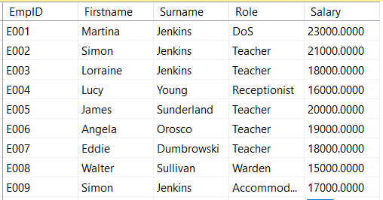
Employees
Notes:
Each employee in the Employees table is given a unique ID – EmpID – as his or her Primary Key.
By adding EmpID, there can be no worries about getting employees mixed up, even if two of them have the same name.

Slide 13
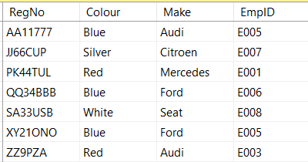
Cars
Notes:
Additional data has been added to the Cars table – Colour and Make.
Each car already has a unique ID – its registration number – so RegNo is the Primary Key in the Cars table.
Note that EmpID, the fourth column of this table, is the primary key from the Employees table. This means it is the foreign key of the Cars table. It is a way of saying that the car with the registration AA11777 belongs to the employee with the ID E005, car JJ66CUP belongs to E007 and so on.
This determines the relationship between Cars and Employees.

